Slide 1
Customer Review Analysis System for Dolce Vita: Enhancing Restaurant Experience through Data Insights
Zahra Hashmi Khamgaowala
Notes:
Imagine a world where every bite you take is not just delicious but part of a perfectly curated experience. That’s the vision behind Customer Review Analysis System for Dolce Vita: Enhancing Restaurant Experience through Data Insights.
Through the power of data, we’re not just analyzing customer feedback—we’re turning it into actionable insights. From understanding what diners love about the food to pinpointing areas where service can shine even brighter, this project aims to elevate Dolce Vita into a dining destination that consistently exceeds expectations.

Slide 2
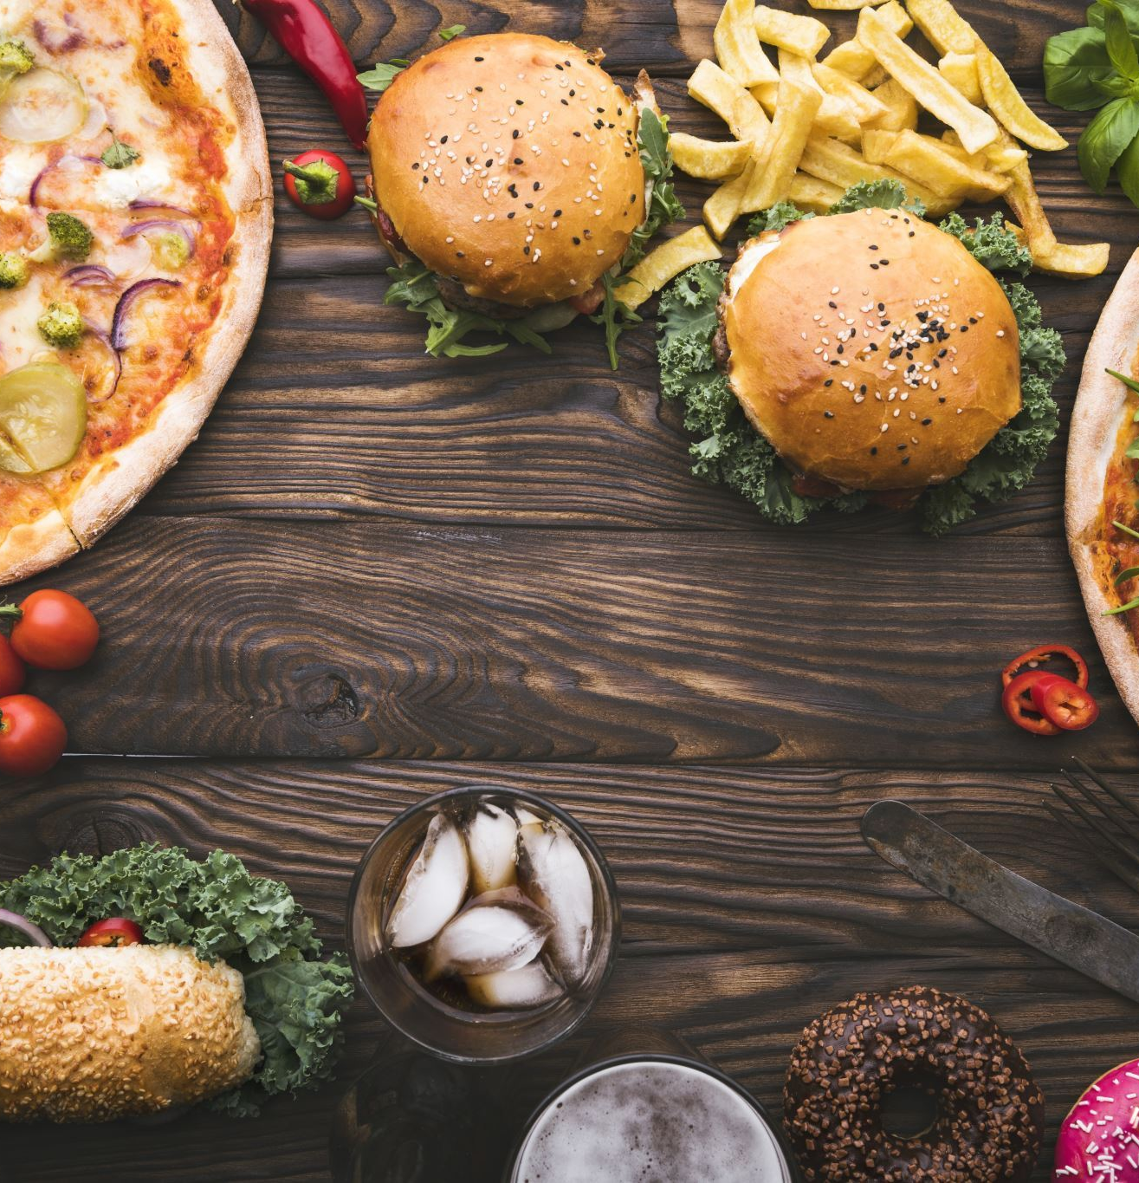
Abstract
This project focuses on customer reviews of Dolce Vita Italian Restaurant, leveraging Aspect-Based Sentiment Analysis and Natural Language Processing (BERT,VADER), Machine Learning (PCA, RandomForest) to extract actionable insights.
Key aspects analyzed include food quality, service, ambiance, and value for money.
Insights enable targeted improvements to enhance customer satisfaction, loyalty, and the restaurant's competitive edge.

Slide 3

Introduction
In today’s competitive dining industry, customer reviews are a key driver of success.
Dolce Vita Italian Restaurant, known for its exceptional Italian cuisine, relies heavily on customer feedback to maintain its reputation.
Platforms like TripAdvisor provide valuable feedback but present challenges due to unstructured data. https://www.tripadvisor.com/Restaurant_Review-g57718-d450346-Reviews-Dolce_Vita_Italian_Restaurant_Wine_Bar-Fairfax_Virginia.html
Web scraping and analyzing unstructured customer reviews is challenging but essential for identifying specific areas of improvement.
This project focuses on extracting insights from reviews and enhancing the restaurant's offerings.

Slide 4
Problem Statement
Restaurants like Dolce Vita receive a large number of reviews on platforms like TripAdvisor, but these reviews are often unstructured and difficult to analyze.
Traditional sentiment analysis provides an overall sentiment (positive, negative, neutral) but fails to identify specific issues like food quality, service delays, or ambiance concerns.
Customer preferences vary by age, location, and season, making it harder to understand what different groups of customers expect.
Without breaking down reviews into detailed components, restaurants miss valuable insights that can help them improve their offerings and customer experience.

Slide 5
Research Questions
How does the sentiment trend for food, service, and ambiance compare over time, and what insights can be drawn about changes in customer experience?
What are the primary factors that contribute to customer dissatisfaction, as reflected in lower ratings and negative comments?
What aspects of the dining experience (service, atmosphere, food quality, value of money) most significantly influence customer ratings?
In what ways do customer demographics affect sentiment regarding specific aspects of the restaurant experience?

Slide 6

Hypothesis
Food quality and service are the most critical drivers of satisfaction.
Preferences differ by demographics, with younger diners favoring innovation and older patrons valuing service.
Addressing specific issues, like slow service, will significantly boost satisfaction.
Seasonal trends influence customer expectations and sentiment.

Slide 7
Proposed Approach
Data Extraction: Web scraping data from TripAdvisor website
Data Preprocessing: Cleaning and formatting data.
Exploratory Analysis: Identifying trends and correlations.
Machine Learning: Predicting customer satisfaction.
NLP and ABSA: Extracting insights from textual data.
Visualizations: Word clouds, heatmaps, sentiment trends.

Slide 8
Dataset
The dataset consists of 411 customer reviews for Dolce Vita Italian Restaurant, collected from TripAdvisor. Reviews were gathered using the Bardeen extension and Python.
Key Features:
Ratings: Numerical ratings for food, service, ambiance, and value for money.
Textual Feedback: Comments on various aspects of the dining experience (e.g., food quality, service, atmosphere).
Metadata: Review date, location, and customer demographic data.
Preprocessing:
Missing data handled by replacing with "Unknown."
Standardization of columns for consistency.
Cleaning of non-numeric entries and irrelevant data.

Slide 9
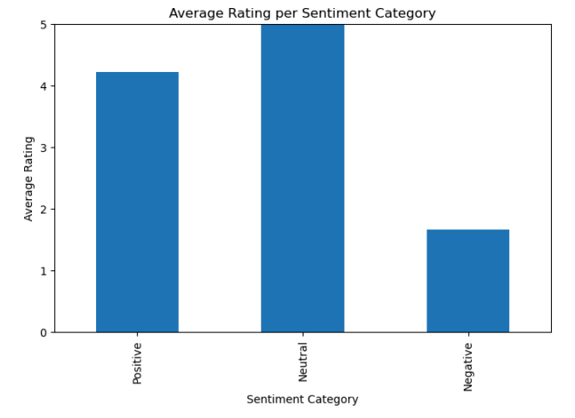
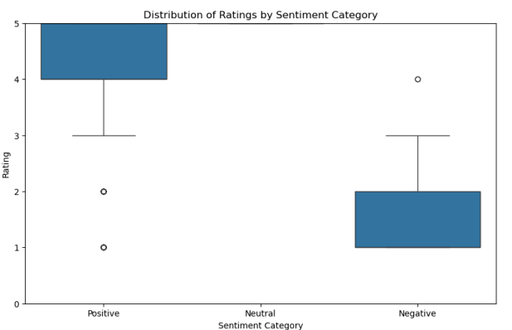
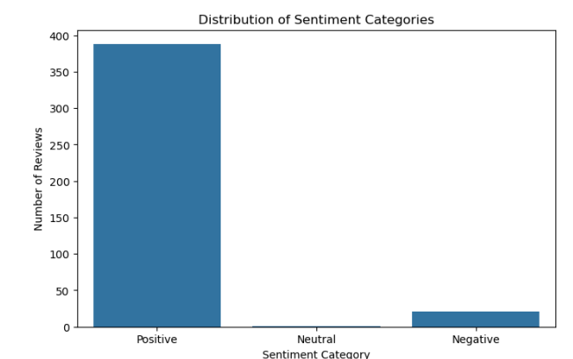
Exploratory Data Analysis
The trend of positive reviews reflect that Dolce Vita has a good reputation among its customers.

Slide 10
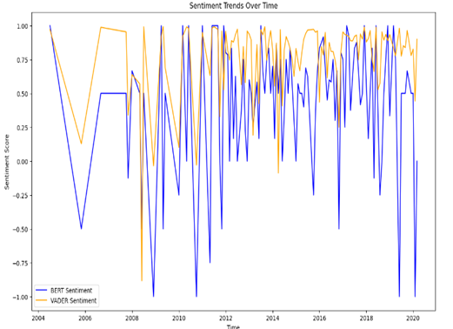
Sentiment trends over time
BERT and VADER Sentiment Analysis were applied to track sentiment for food, service, and ambiance over time.
Sentiment trends show fluctuations throughout the year, with peaks and dips indicating customer satisfaction patterns, such as more positive feedback during holidays and occasional declines in certain months.
Fig 1. General Sentiment trends over time
Notes:
The first graph showcases the sentiment trends over time for BERT (blue line) and VADER (orange line).
Both lines represent sentiment scores ranging from -1 (negative sentiment) to 1 (positive sentiment) across a timeline spanning 2004 to 2020.
Sentiment scores fluctuate significantly over time, indicating diverse customer feedback trends.
Positive peaks are likely associated with high customer satisfaction, such as during holidays or major promotions.
Negative dips might correlate with operational challenges, poor service, or external factors.

Slide 11
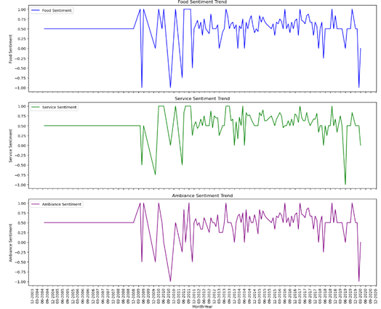
Sentiment trends over time
Tracks sentiment (positive/negative) for food, service, and ambiance over time.
Specific sentiment trends for each category reveal that food quality and service are key drivers of customer satisfaction, while ambiance fluctuates based on seasonal factors and operational changes.
Seasonal peaks (e.g., December) and dips, revealing trends in customer satisfaction and areas needing improvement.
Fig 2. Specific – category Sentiment trends over time
Notes:
Food Sentiment:
Observes considerable fluctuations, likely tied to variability in food quality or menu changes.
Sustained positive periods indicate consistent customer approval, while sudden dips highlight specific incidents needing attention.
Service Sentiment:
Displays more stable trends than food but still has occasional dips, which might be tied to inconsistent customer service experiences.
Improvements in staff training or efficiency could stabilize scores.
Ambiance Sentiment (Purple):
Shows the least variability, suggesting that ambiance is less impacted by short-term changes.
Seasonal peaks (e.g., festive decorations) and occasional troughs provide actionable opportunities for improvement.

Slide 12
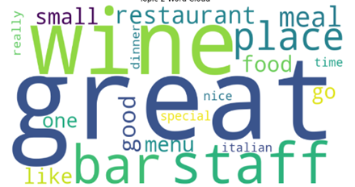
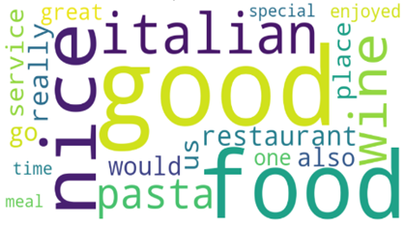
Key Factors Influencing Ratings
The word cloud for customer service highlights positive words and phrases frequently mentioned in reviews like "great," "attentive," and "helpful" suggest that customers appreciate exceptional service.
The word cloud for food shows key phrases such as "pasta," "wine," and "delicious", which are commonly mentioned in positive reviews. These terms suggest that customers particularly enjoy the quality of the Italian cuisine, especially the pasta and wine offerings.
Word cloud- Customer service and food

Slide 13
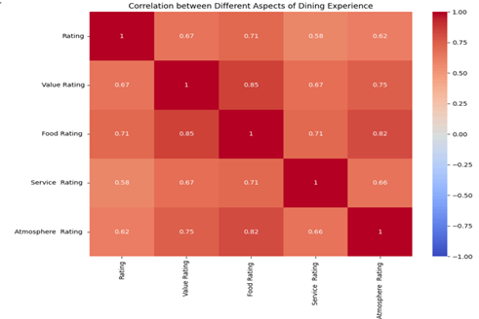
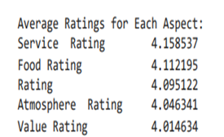
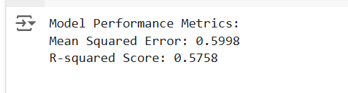
Key Factors Influencing Ratings
This heatmap shows the strength of relationships between different aspects (food quality, service, ambiance, and overall rating).
Strong correlations between food quality, service, and overall rating indicate that improvements in these areas directly impact overall customer satisfaction.
This analysis reveals that food quality contributes the most to the variance in customer ratings, making it the most significant factor in shaping customer perceptions.

Slide 14
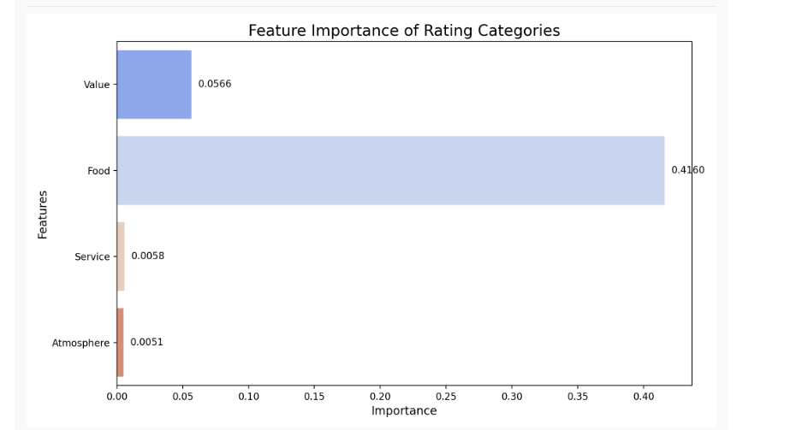
Key Factors Influencing Ratings
Key Takeaway
The analysis shows that food quality and value for money are the most critical factors influencing customer ratings. Good service and ambiance help but are not as impactful. The prediction model aligns with these insights, providing confidence in the results.

Slide 15
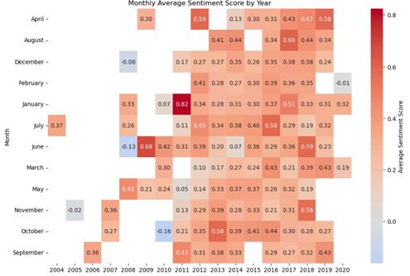
Demographic Influence on Sentiment
This heatmap compares monthly sentiment scores for each year and it shows spikes in customer sentiment during the holiday season, indicating that external factors such as festive events or special promotions positively impact satisfaction.

Slide 16
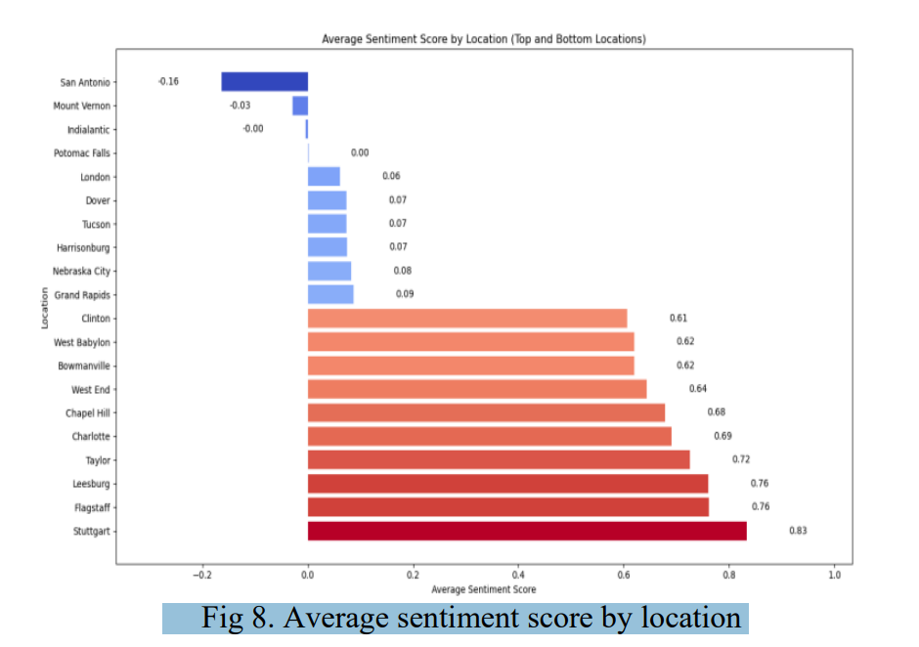
Demographic Influence on Sentiment
This figure highlights sentiment variations by location, showing that some regions have higher satisfaction (e.g., Stuttgart, Flagstaff) while others (e.g., San Antonio, Mount Vernon) have lower sentiment.
Regional preferences and expectations influence sentiment, helping identify areas where service or menu adjustments may be needed to improve customer satisfaction.

Slide 17
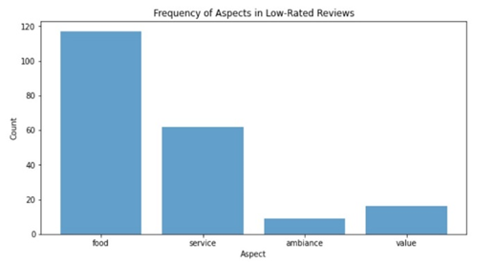
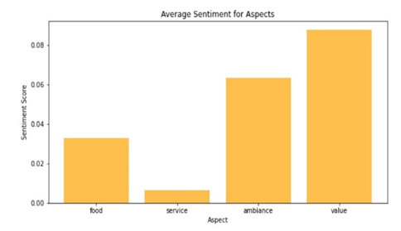
Customer Dissatisfaction Factors
Compares mentions of food , ambiance ,value and service in low-rated reviews.
Confirms food and service have the lowest sentiment scores, indicating these are critical areas to improve.

Slide 18
Key findings
Positive Feedback Trends:
Customer sentiment shows a general recovery after temporary declines. This indicates that issues identified in reviews were addressed, leading to an improvement in customer satisfaction.
Food Quality and Service as Primary Satisfaction Drivers:
Analysis consistently shows that food quality and service have the strongest influence on overall customer satisfaction. Customers frequently mention these two aspects in both positive and negative reviews.
Actionable Insights for Management:
Visualizations, such as sentiment trends, word clouds, provide clear and actionable insights into customer preferences and dissatisfaction points. Management can use these insights to prioritize improvements in food quality, staff training for better service, and identify areas where the customer experience can be enhanced.

Slide 19
Conclusion and future work
Key Areas for Improvement:
The analysis highlights food quality and service as the most critical factors influencing customer satisfaction. Improving these areas will lead to higher ratings and stronger customer loyalty.
Data-Driven Insights:
By leveraging ABSA and NLP, Dolce Vita can continuously monitor customer feedback, identify dissatisfaction points, and address them proactively, ensuring consistent improvements.
Long-Term Strategy:
Focusing on customer experience through detailed feedback analysis will not only resolve immediate concerns but also help Dolce Vita build a stronger, more competitive position in the restaurant industry.
Scalability:
The insights and approach from this project can be expanded to other locations or restaurants, providing a scalable model for improving customer experience across the brand.

Slide 20
References
TripAdvisor, "Dolce Vita Italian Restaurant & Wine Bar," 2024. [Online]. Available: https://www.tripadvisor.com/Restaurant_Review-g57718-d450346-Reviews-Dolce_Vita_Italian_Restaurant_Wine_Bar-Fairfax_Virginia.html.
K. Schouten and F. Frasincar, "Survey on Aspect-Level Sentiment Analysis," IEEE Transactions on Knowledge and Data Engineering, vol. 28, no. 3, pp. 1–12, Mar. 2016, doi: 10.1109/TKDE.2016.2530568.
M. Pontiki, A. Papageorgiou, and V. Karkaletsis, "SemEval-2016 Task 5: Aspect-Based Sentiment Analysis," in Proceedings of the 10th International Workshop on Semantic Evaluation (SemEval-2016), San Diego, CA, USA, Jun. 2016. [Online]. Available: https://aclanthology.org/S16-1002.pdf.
J. Tao and T. Tan, "Affective Computing: A Review," Lecture Notes in Computer Science, vol. 3784, pp. 981–995, Dec. 2005. [Online]. Available: https://link.springer.com/chapter/10.1007/11573548_125.
S. Poria, E. Cambria, and A. Hussain, "Aspect-Based Sentiment Analysis Using a Deep Learning Approach," ScienceDirect, 2016. [Online]. Available: https://www.sciencedirect.com/science/article/abs/pii/S1574013723.

Slide 21

Thank you!

